Slide 1
The Dynamic Cuckoo Filter
Authors: | Hanhua Chen, Liangyi Liao, Hai Jin, Jie Wu
Publisher: | 2017 ICNP
Presenter: | Tzu-Chieh, Lin
Date: | 106/11/08

Slide 2
INTRODUCTION
The emergence of large-scale dynamic sets in real applications creates stringent requirements for approximate set representation structures.
(1) The capacity of the set representation structures should support flexibly extending or reducing to cope with dynamically changing of set size.
(2) The set representation structures should support reliable delete operation.
Existing techniques for approximate set representation e.g., the cuckoo filter, the Bloom filter and its variants cannot meet both the requirements of a dynamic set.

Slide 3
RELATED WORK
Standard Bloom filter
Counting Bloom filter
Cuckoo filter
Dynamic Bloom filter

Slide 4
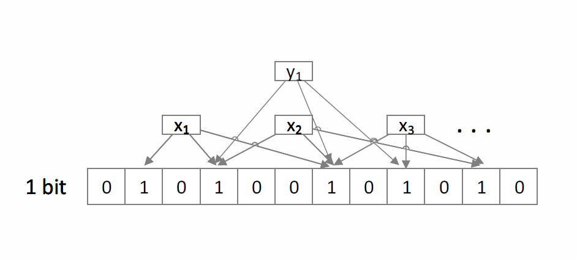
Bloom filter(BF)

Slide 5
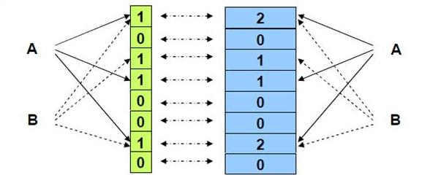
Counting Bloom filter(CBF)
Counting Bloom filter (CBF) [9] replaces each bit of an BF with a counter of s bits to support item deletion.
However, the space cost of a CBF is s times larger than the SBF.

Slide 6
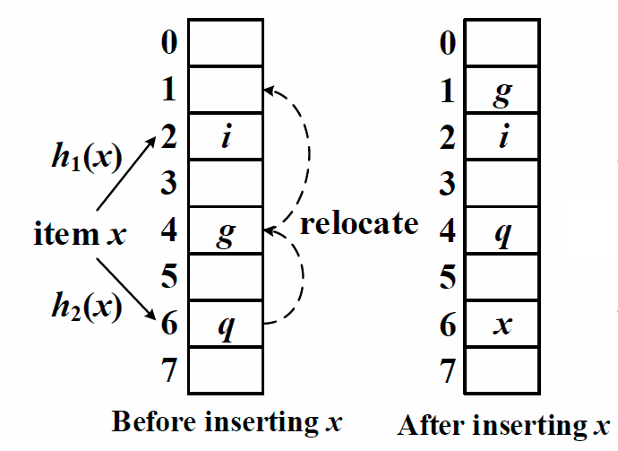
Cuckoo Hash
A basic cuckoo hash table consists of an array of buckets where each item has two candidate buckets determined by hash functions h1(x) and h2(x).
The lookup procedure checks both buckets to see if either contains this item.
Support insert and delete.

Slide 7
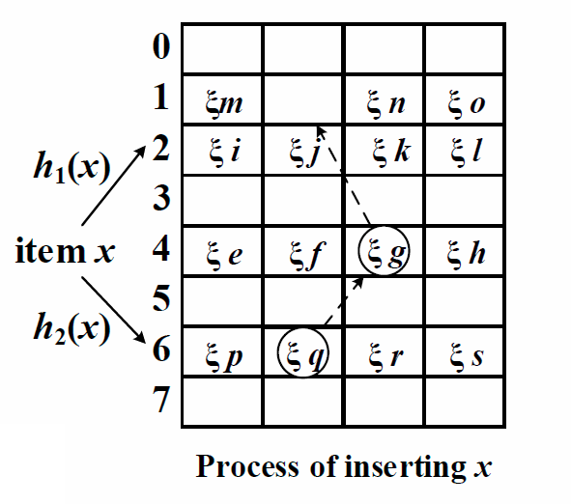
Cuckoo Filter(CF)
An array of buckets
Each bucket has b entries
Fingerprint based matching
Relocation when collision
${\text{ξ}}_{x}={hash}_{m}(x)$

Slide 8
Dynamic Bloom Filter
Linked list of s Counting Bloom Filters (CBF).
Extends capacity by appending new building blocks of CBFs.
Drawback: unreliable deletion.

Slide 9
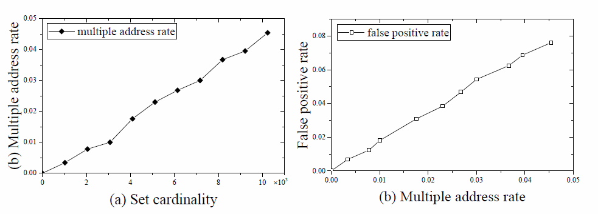
Multiple Address Problem in DBF
Give up deleting the element found in multiple building blocks.
Raises up false positives.

Slide 10
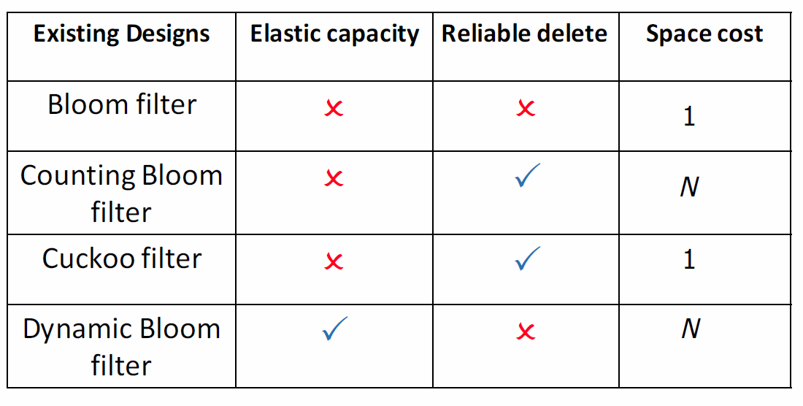

Slide 11
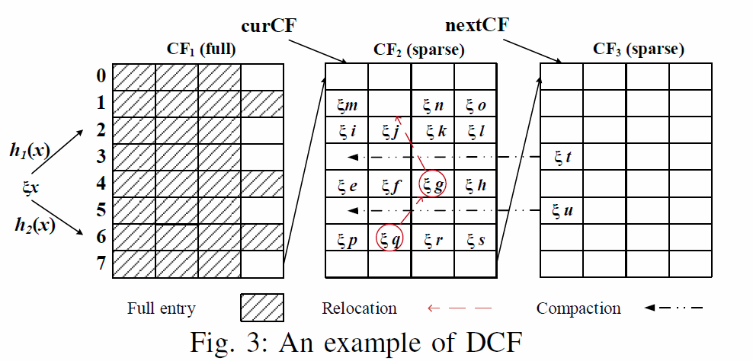
Dynamic Cuckoo Filter
DCF uses Cuckoo Filter(CF) as building block.
Extends capacity by appending new building blocks.
Monopolistic fingerprint avoid multiple address problem.

Slide 12
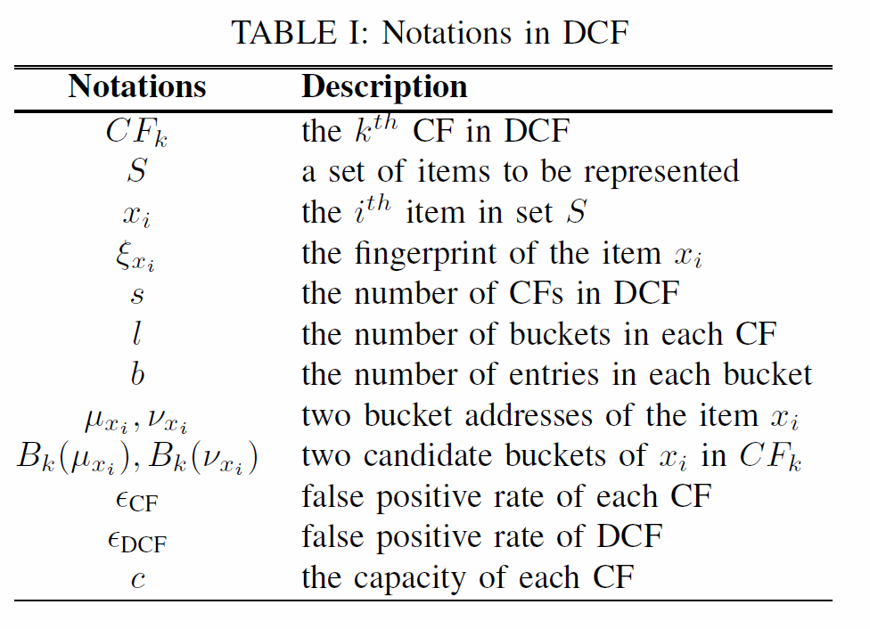

Slide 13
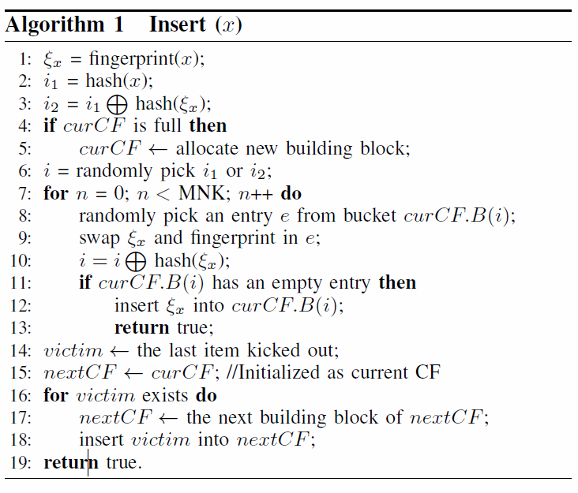
Insert
The algorithm keeps two pointers, curCF and nextCF. The curCF points to the current CF and if the curCF is full, then new CF building block will be allocated and assigned to curCF.
If the number of relocation reaches the specified maximum value, denote as MNK, the algorithm will record the last fingerprint kicked out, denote as victim. In order to avoid insert failure, the victim will be keep inserted into the nextCF iteratively.

Slide 14
Insert
ξm |  | ξn | ξo
ξi | ξj | ξk | ξl
ξe | ξf | ξg | ξh
ξp | ξq | ξr | ξs
ξm | ξg | ξn | ξo
ξi | ξj | ξk | ξl
ξe | ξf | ξq | ξh
ξp | ξx | ξr | ξs
$$h_{1}(x)$$
ξx
$$h_{2}(x)$$

Slide 15
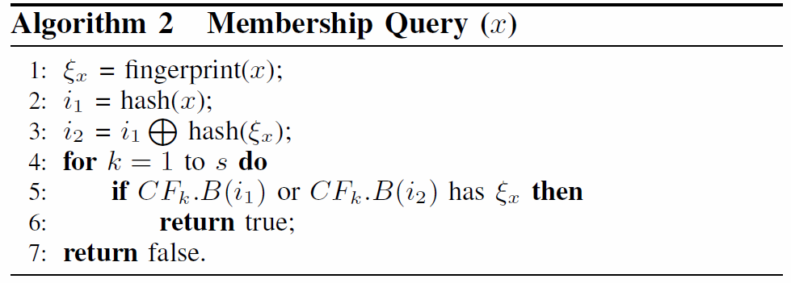
Query
Membership testing with a DCF needs to probe every CF in the DCF, i.e., 2bs entries, in the worst case.
The time complexity of the membership query operation of a DCF and a CF are O(bs) and O(b), respectively.

Slide 16
Query
ξm | ξg | ξn | ξo
ξi | ξj | ξk | ξl
ξe | ξf | ξq | ξh
ξp | ξx | ξr | ξs
$$h_{1}(x)$$
ξx
$$h_{2}(x)$$

Slide 17
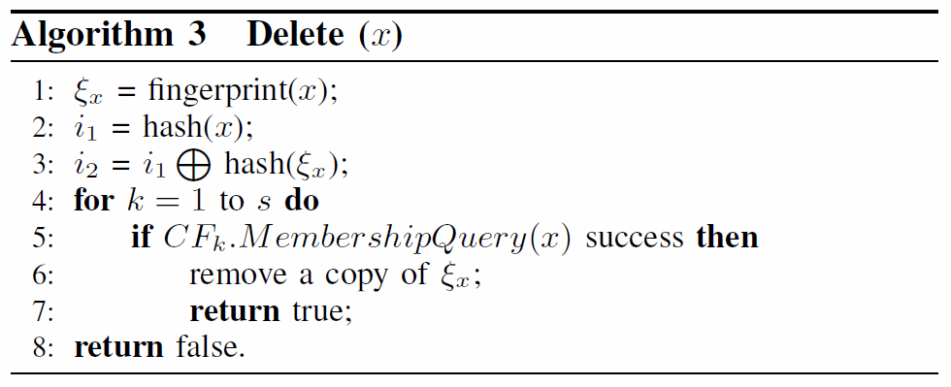
Delete
The deletion of an item x needs to first perform a membership query operation. If a corresponding fingerprint ξ x is found, then the matched fingerprints will be removed.
The time complexity of the delete operation is the same as those of the membership query operation, i.e., O(bs) for a DCF and O(b) for a CF.

Slide 18
Delete
ξm | ξg | ξn | ξo
ξi | ξj | ξk | ξl
ξe | ξf | ξq | ξh
ξp | ξx | ξr | ξs
ξm | ξg | ξn | ξo
ξi | ξj | ξk | ξl
ξe | ξf | ξq | ξh
ξp |  | ξr | ξs
$$h_{1}(x)$$
ξx
$$h_{2}(x)$$

Slide 19
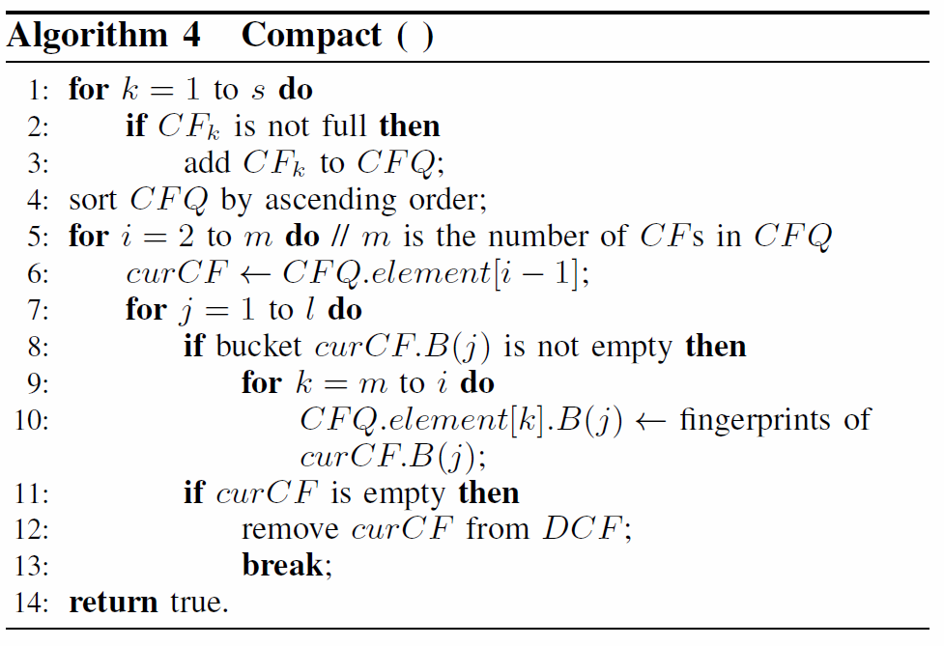
Compact
The compact operation of the DCF iteratively moves the fingerprints from sparse CFs to their counterpart buckets in other denser CFs.

Slide 20
Compact
CF1(dense)
CF2(sparse)
ξm | ξg | ξn | ξo
ξi | ξj | ξk | ξl
ξe | ξf | ξq | ξh
ξp | ξx | ξr | ξs
ξt
ξu
ξm | ξg | ξn | ξo
ξi | ξj | ξk | ξl
ξt
ξe | ξf | ξq | ξh
ξu
ξp | ξx | ξr | ξs

Slide 21
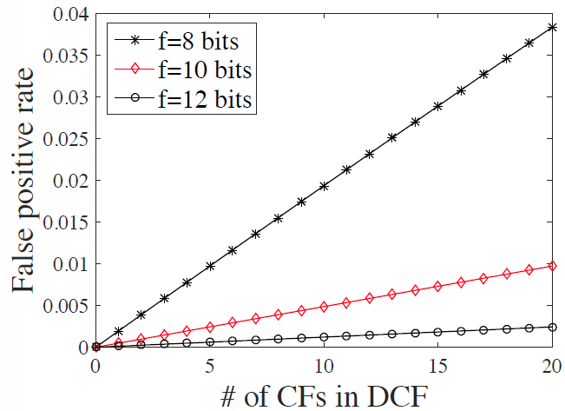
False Positive Rate
The false positive rate is defined as the probability that at least one CF among all the CFs reports a false positive for x.

Slide 22
Multiple Value
Diverse items have very low probability to be inserted with the same fingerprint in the same bucket address in the DCF design.
Considering the case that the items x and y share the same bucket address and happen to collide in the same fingerprint (ξx = ξy).
Even if the DCF encounters multiple value, removing one matched fingerprints does not lead to redundant information left thanks to the monopolistic fingerprint. This guarantees that no false negative is introduced.

Slide 23
Dulpicates
Assuming the item x has been inserted twice, there must be two copies of the fingerprint ξ x inserted in the DCF. Obviously, deleting item x thoroughly requires removing fingerprint ξ x twice.
If inserting duplicated items is not allowed, the DCF can filter the duplicate by performing a query operation before insertion.
This guarantees that items can be removed thoroughly by removing fingerprint once. At the same time, it might introduce slight false negatives.

Slide 24
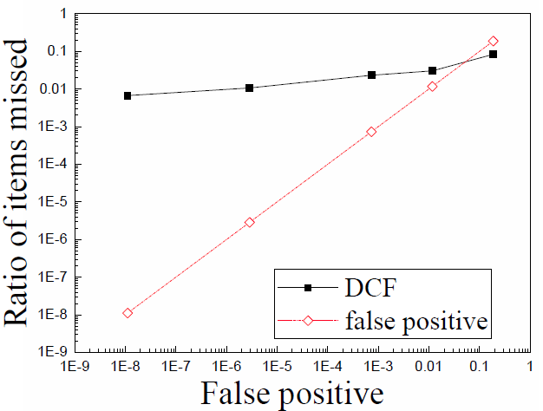
Dulpicates
Considering the case that we mentioned in multiple value, items x and y share the same bucket address and happen to collide in the same fingerprint (ξ x = ξ y).
When x and y both need to be inserted into the DCF, only one copy of the fingerprint is inserted to avoid duplicates. After inserting a single copy, a possible false negative may occur.
For example, item y will no longer be found if we delete item x.

Slide 25
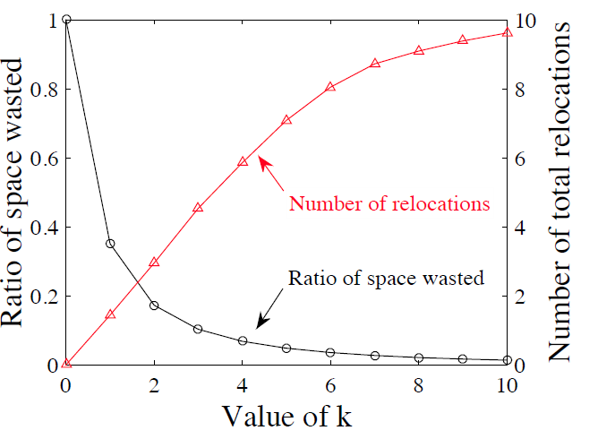
OPTIMIZATION

Slide 26
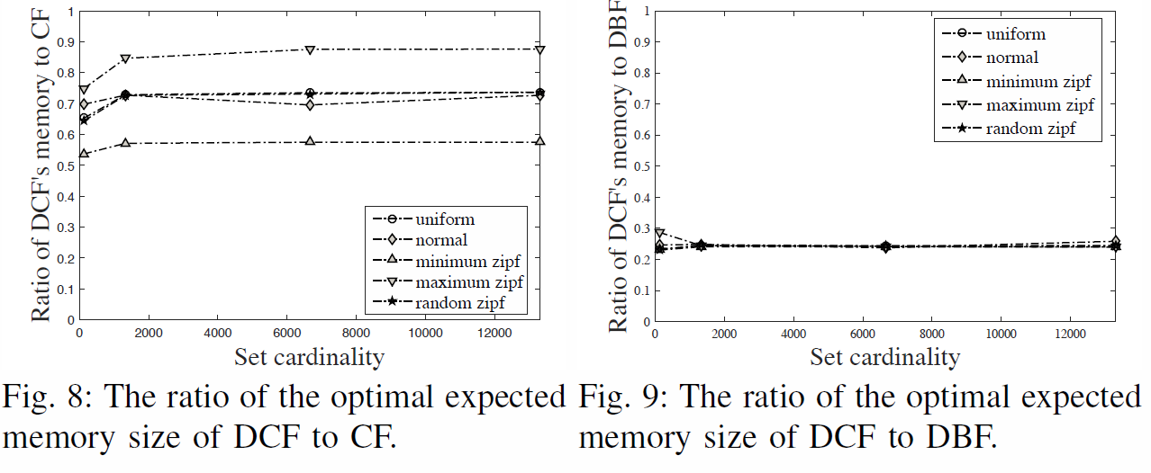

Slide 27
PERFORMANCE
We choose SHA1 to generate hash values. In the DCF implementation, we use the highest 32 bits and the lowest 32 bits to represent the fingerprint and one of the bucket address, respectively.
In the experiment, we set the false positive rates of both the DCF and the DBF to a fixed value of $1.17×{10}^{−2}$.
In the first experiment we fix the parameter s at six for both the DCF and the DBF, and configure both the DCF and the DBF with the space optimized parameter settings when varying the size of a dynamic set from zero to 64,512..
The second experiment evaluate the influence of the parameter s. We fix the set cardinality at 46,080 and vary the value of s to examine how it affects the operation performance

Slide 28
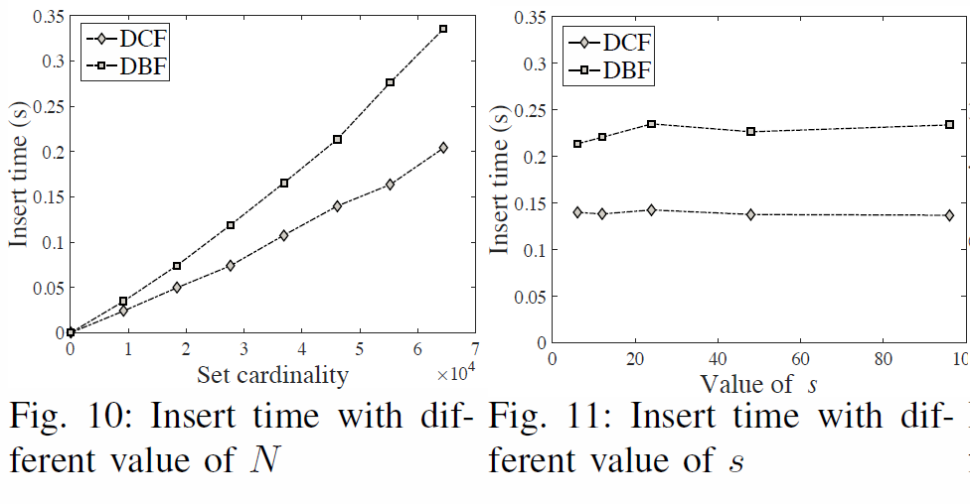
PERFORMANCE - Insert

Slide 29
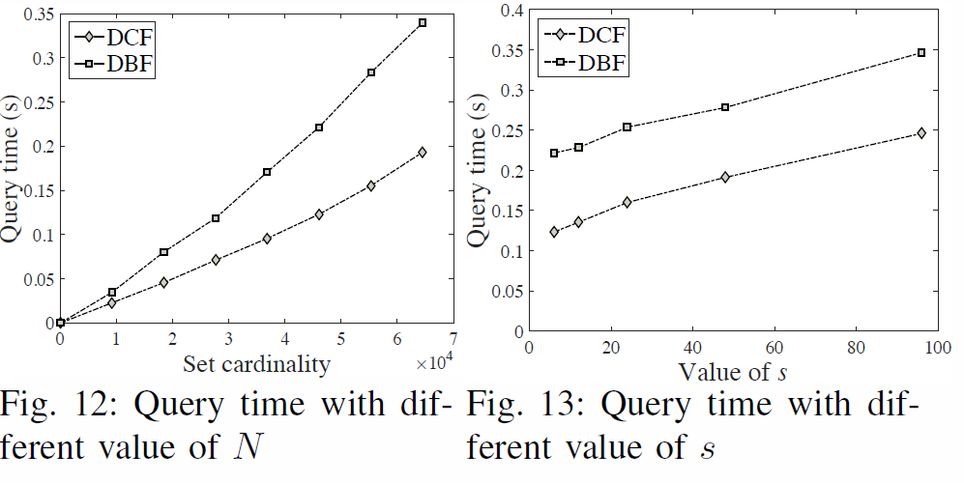
PERFORMANCE - Query

Slide 30
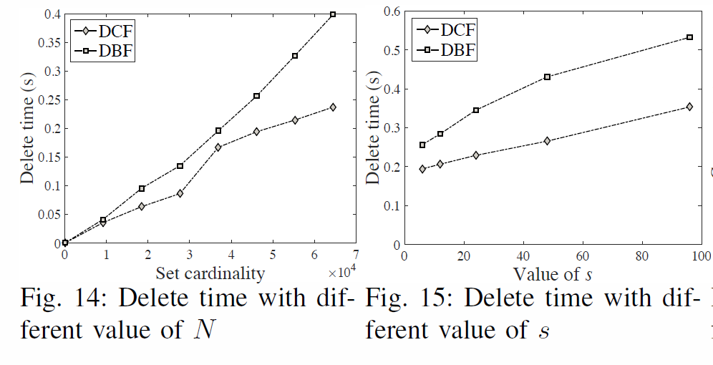
PERFORMANCE - Delete

Slide 31
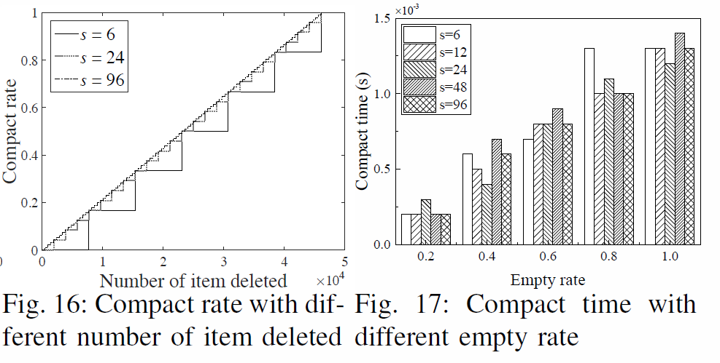
PERFORMANCE - Compact

